Slide 1
MODULE IV
TIGHTLY COUPLED MULTIPROCESSOR

Slide 2
Throughput of a loosely coupled multiprocessor may be too low for applications that require fast response times
If high speed or real-time processing is desired, Tightly coupled systems(TCS) may be used
2 models of a TCS :-
without private cache
with private cache

Slide 3
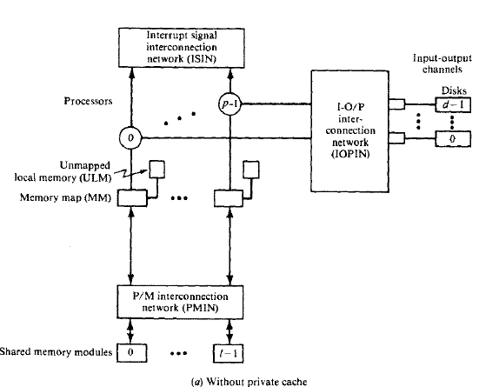
Tightly coupled multiprocessor without private cache

Slide 4
Tightly coupled multiprocessor without private cache
It consists of p processors, l memory modules, d I/O channels
These are interconnected through a set of 3 interconnection networks
processor-memory interconnection n/w (PMIN)
I/O-processor interconnection n/w (IOPIN)
Interrupt-signal interconnection n/w (ISIN)
PMIN is a switch which can connect every processor to every memory module
This switch is a p by l crossbar which has pl set of cross-points

Slide 5
A memory module can satisfy only one processor’s request in a given memory cycle
If 2 or more processors attempt to access the same memory module, a conflict occurs, which is resolved by PMIN
PMIN may be designed to permit broadcasting of data from one processor to 2 or more memory modules
Another method to reduce conflicts is :- associate a reserved storage area with each processor (ULM)

Slide 6
Unmapped Local Memory (ULM)
For e.g. : if each processor is multiprogrammed, the state of process to be blocked may be saved in ULM
Hence ULM helps in reducing traffic in PMIN and hence the degree of conflicts
Disadvantage : each processor may make memory references which are accessed in main memory, memory references contribute to memory conflicts

Slide 7
With private cache
Delay caused by memory reference can be reduced by associating a cache with each processor to capture most of the references made by processor
There is a module attached to each processor that directs memory references to either ULM or private cache of that processor
This module is named as Memory Map
ISIN permits each processor to direct an interrupt to any other processor
IOPIN permits a processor to communicate with an I/O channel which is connected to peripheral devices

Slide 8
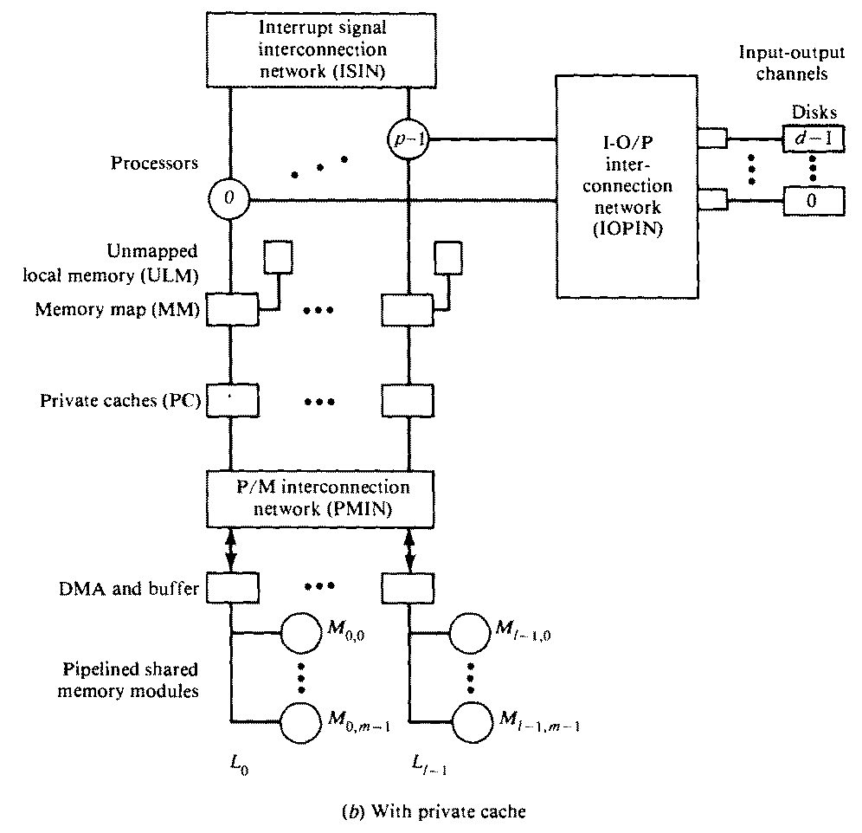

Slide 9
3 e.g. of tightly coupled multiprocessors are
Cyber-170 architecture
Honeywell 60/66 architecture
PDP-10 multiprocessor

Slide 10
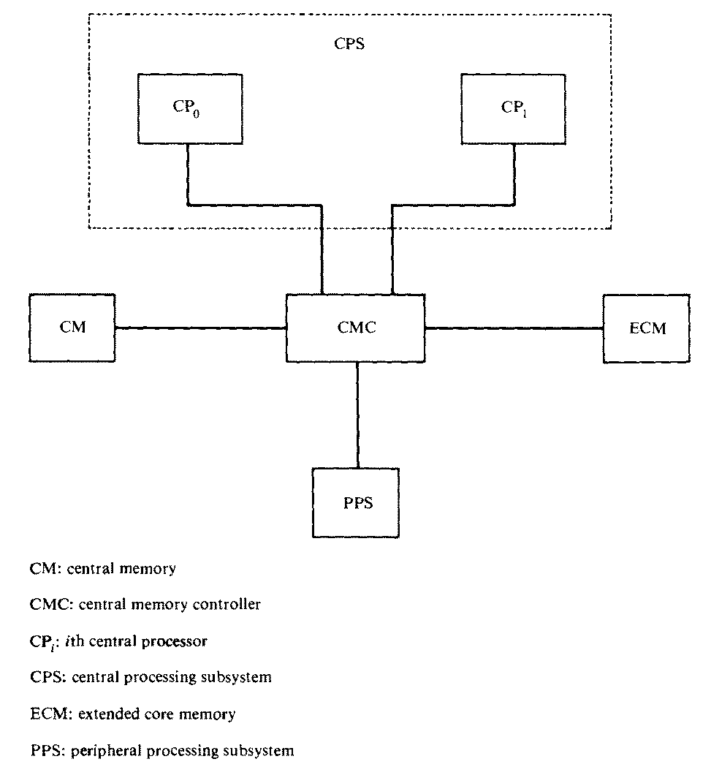
Cyber-170 Architecture

Slide 11
This configuration consists of 2 subsystems: Central processing subsystem & peripheral processing subsystem
These subsystems have access to a common central memory (CM) through a central memory controller (CMC)
There is an optional secondary memory called extended core memory (ECM) which is a low-speed random-access read-write memory

Slide 12
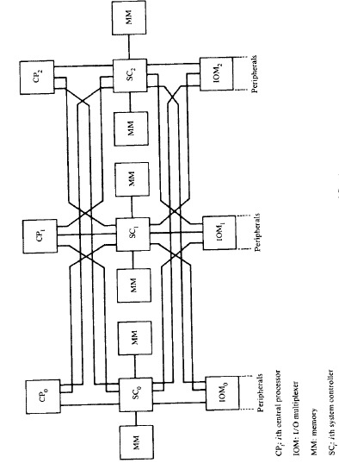
Honeywell 60/66 architecture

Slide 13
Every central processor & every I/O multiplexer is connected to every system controller (SC)
SC acts as a memory controller for its associated pair of memory modules
SC also acts as an intelligent switch to route interrupts and other communications among various system components
When more than one element attempts to access the same memory module, the corresponding system controller (SC) resolves the conflict

Slide 14
PDP-10 Multiprocessor
2 configurations :
Asymmetric master-slave configuration
Symmetric configuration

Slide 15
Asymmetric master-slave configuration
2 processors are identical, but asymmetry is a result of connection of peripherals to master only
Slave cannot initiate peripheral operations nor respond to an interrupt directly

Slide 16
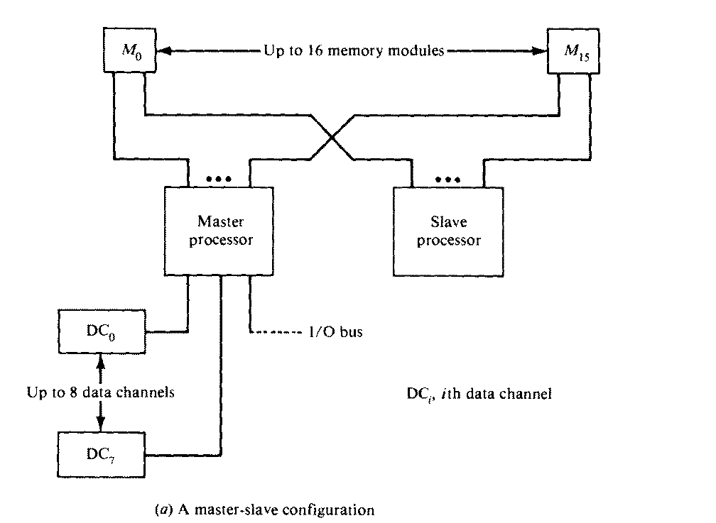

Slide 17
Symmetric configuration
Both processors are connected to a set of shared fast and slow peripherals
Each data channel is attached to one processor
Slow peripherals are connected to both processors via a switch

Slide 18
